Slide 1
Python for CSS
SICSS 2025 Émilien Schultz - CREST/GENES

Slide 2
Overview
10h - Using Python (for social sciences) ?
11h - The basics of the language
12h - Toolkit for SICSS
A space to discuss - please interrupt

Slide 3
What we won’t do (today)
Complete training in Python
Available ressources
Specifity of social science practices
Use cases will be seen next week
Not dedicated to NLP/AI
General approach

Slide 4
M1 - Using Python (for social sciences)

Slide 5
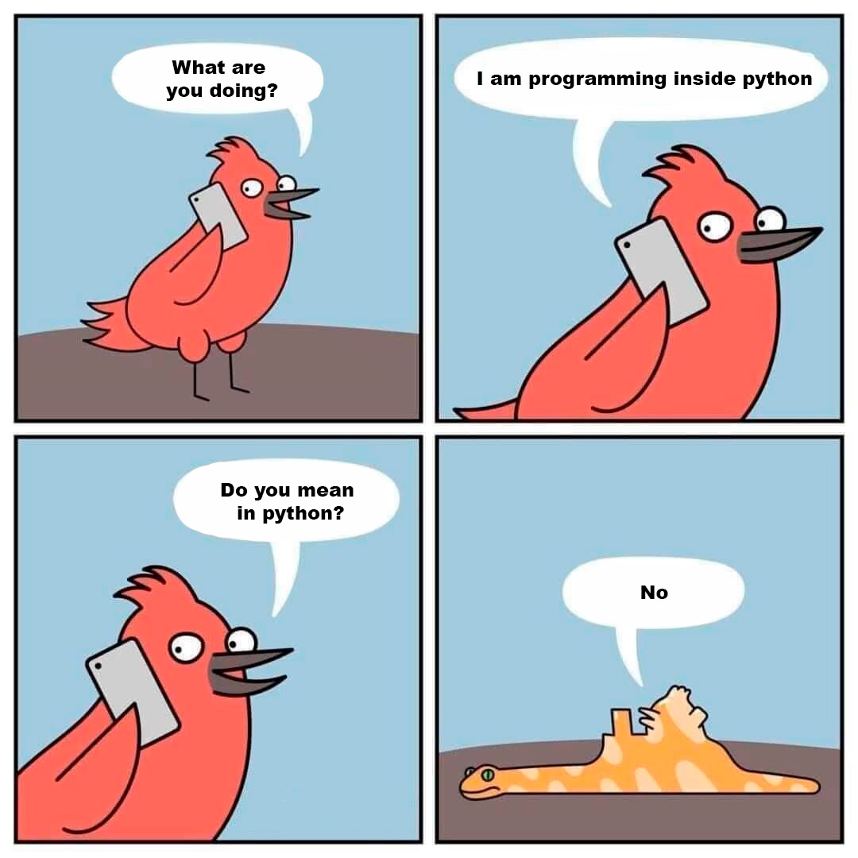
Goals
Starting smoothly with 2 questions :
What is Python ?
Why to use it in research ?

Slide 6
From where we start
Programming ?
Employing a formalized set of instructions to control the operations of a computer
A sequence of mediations from ideas to silicium
A material (computer) with an architecture
One or several layers of abstraction
A final language to control them all

Slide 7
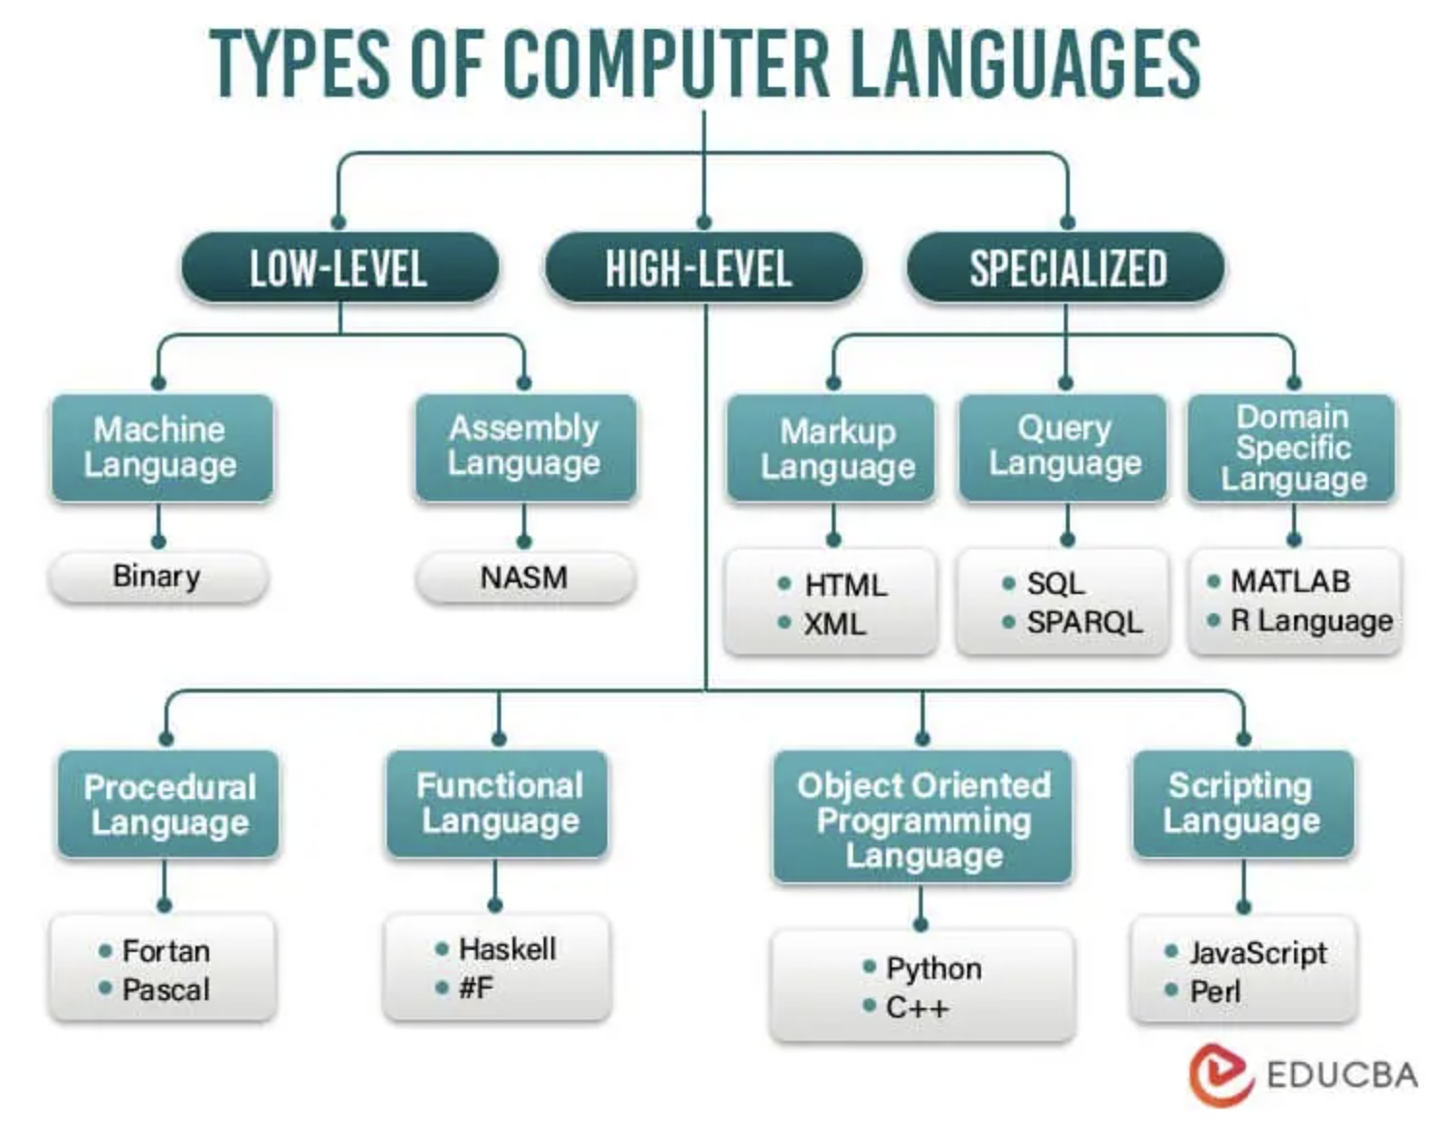
Different programming languages

Slide 8
Scientific programming as a paradigm
Script: perform small specific tasks
Interactivity: test and experiment
Specificity: use of specialized tools
Temporary: constantly evolving
“Amateurism”: not the core of the profession
« in contrast to software engineering, there is no externally specified goal or design target. Instead, the user explores and discovers their goal as they gain understanding from iteratively executing the code and thinking about the results and their data. » (Granger et Perez, 2021)

Slide 9
Why Python ?

Slide 10

Because everything is possible

Slide 11
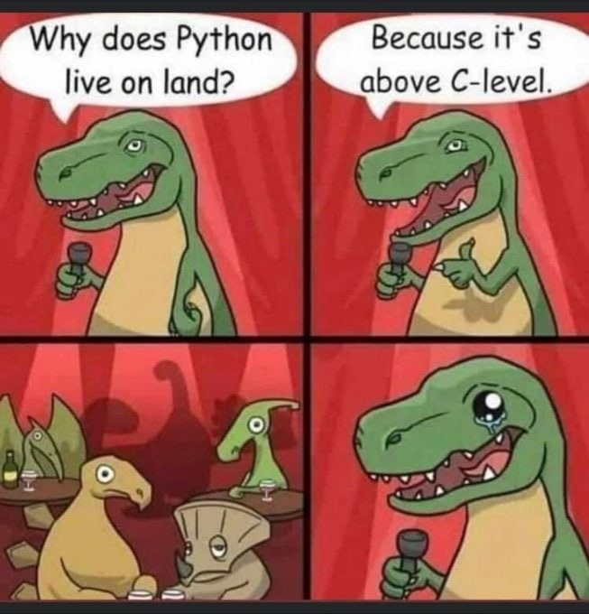
Because it is a high-level language

Slide 12
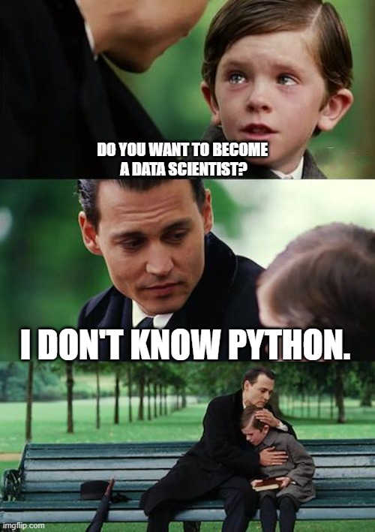
Because data science

Slide 13
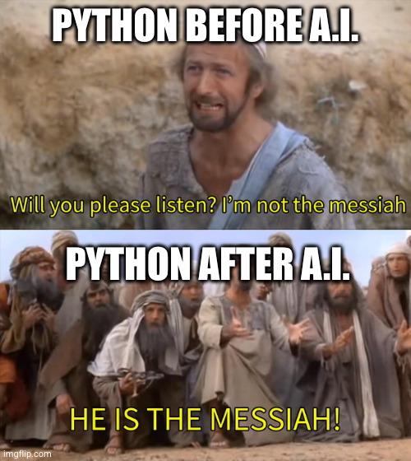
Because the AI turn

Slide 14
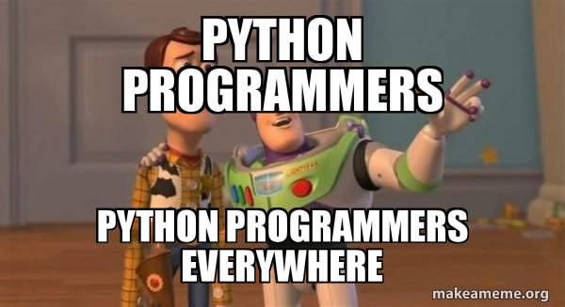
As a consequence : a lingua franca

Slide 15
Especially if you need to work with computer science

Slide 16
Python ID card
Free and interoperable
Versatile
Intuitive by design
The most widely used (thanks AI)
Stackoverflow ; TIOBE index ; Github

Slide 17
Product of an history
The Origins of Python, Lambert Meertens, Inference, 2022
"It makes sense to think of the realm of programming languages as an ecosystem in which languages occupy their own niches. FORTRAN’s niche is high-performance scientific programming, involving heavy-duty numerical computation; that of COBOL is administration, based on files of data records. The C language is designed for systems programming, originally developed specifically for the Unix operating system. Just as there is no such thing as a general-purpose transportation vehicle, a truly one-size-fits-all general-purpose programming language does not exist; for a given highly specialized application domain it will always be possible to design a language tailored to, and better suited for, the specific needs of that domain [...] Python was originally designed to serve as a high-level scripting language for the Amoeba project. ABC was completely unsuitable for this purpose; it lived in a world of its own, shielding its users—by design—from the outside world. Python was expressly designed to interface with that outside world"

Slide 18
A core philosophy
Beautiful is better than ugly.
Explicit is better than implicit.
Simple is better than complex.
Complex is better than complicated.
Flat is better than nested.
Sparse is better than dense.
Readability counts.
Special cases aren’t special enough to break the rules.
Although practicality beats purity.
Errors should never pass silently.
Unless explicitly silenced.
In the face of ambiguity, refuse the temptation to guess.
There should be one– and preferably only one –obvious way to do it.
Although that way may not be obvious at first unless you’re Dutch.
Now is better than never.
Although never is often better than right now.
If the implementation is hard to explain, it’s a bad idea.
If the implementation is easy to explain, it may be a good idea.
Namespaces are one honking great idea – let’s do more of those!

Slide 19
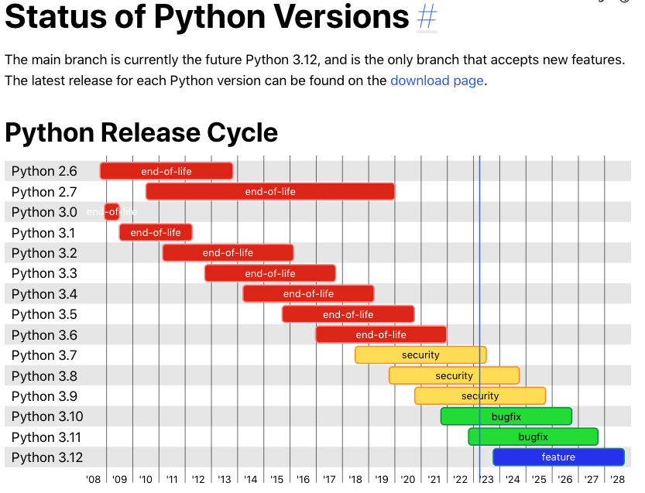
A language is evolving

Slide 20
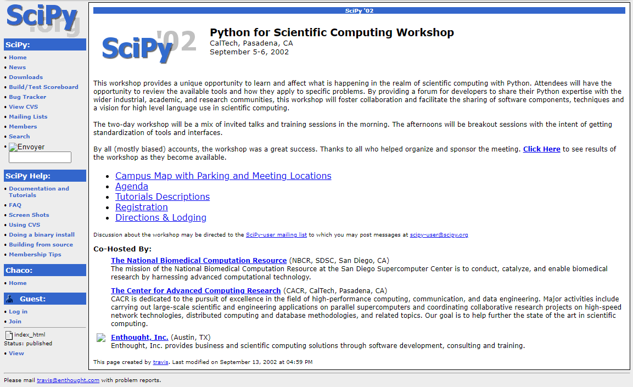
Connected to the scientific practive

Slide 21
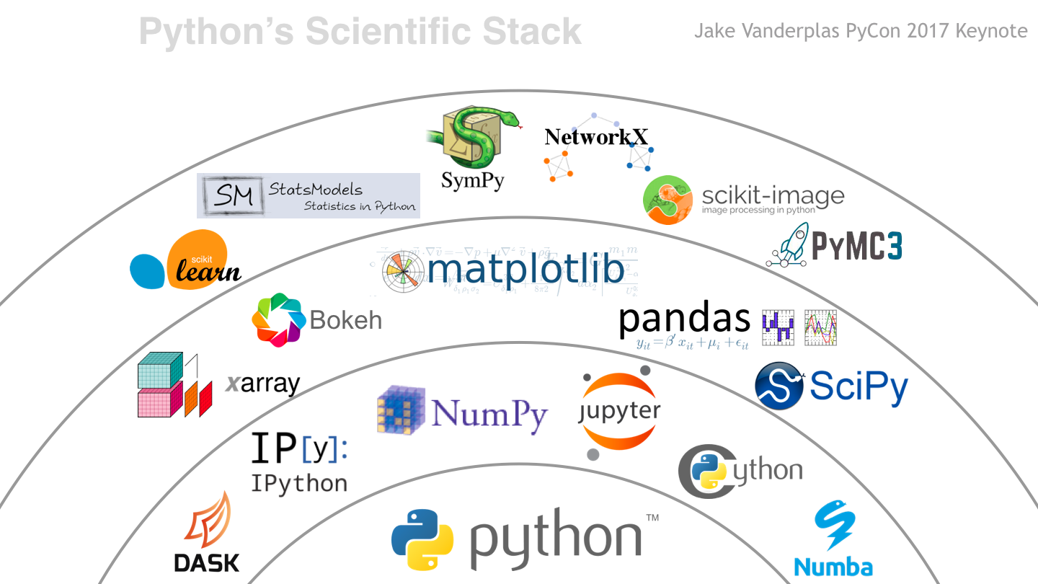
A language + an ecosystem

Slide 22
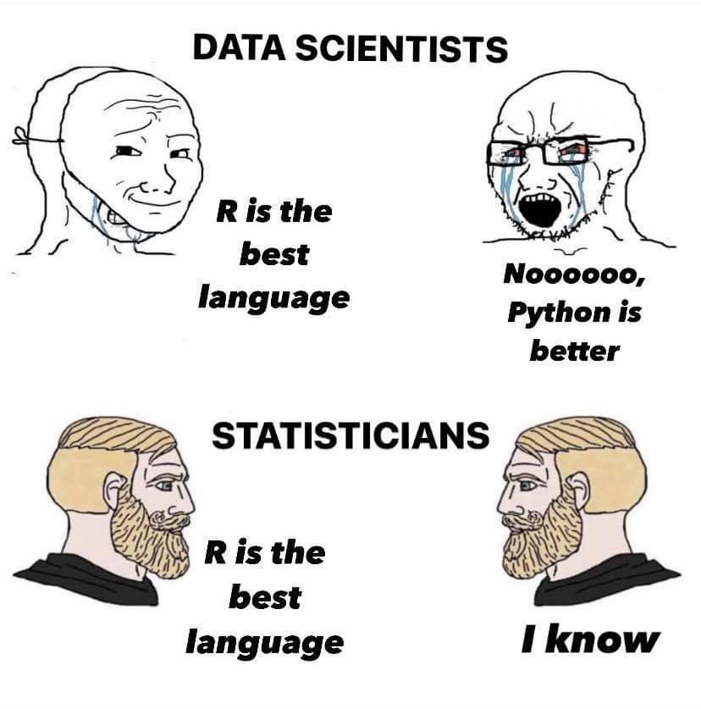
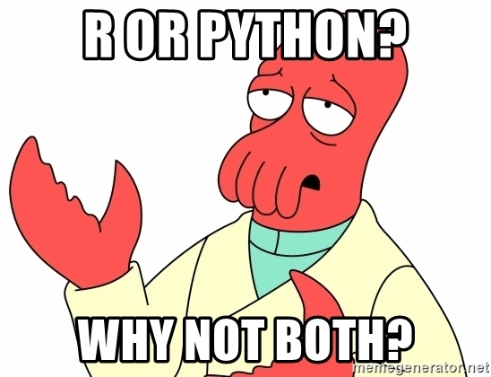
New in social sciences

Slide 23
“the best second langage” … but the first in AI.

Slide 24
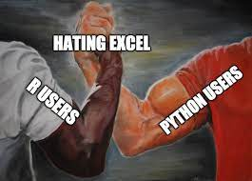
Python or R ?
Python & R ++ data analysis
Python ++ software developement
R ++ statistics
Python ++ ML & IA
Python ++ production

Slide 25
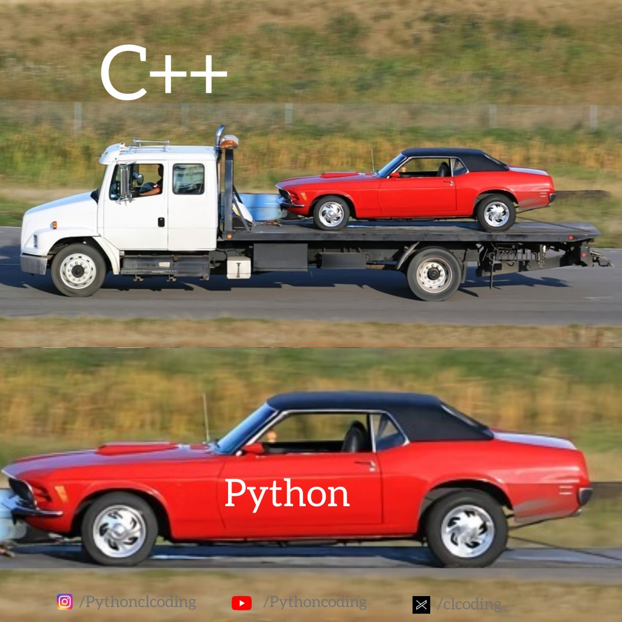
A glue language
use to pilote other languages

Slide 26
How to learn Python ?
Programming in research != software developer
Importance of the general philosophy
Steps :
Notions of syntax & reading scripts
Launching & modifying scripts
Writing your own functions
Using the ecosystem
GenAI can help but also can prevent learning…

Slide 27
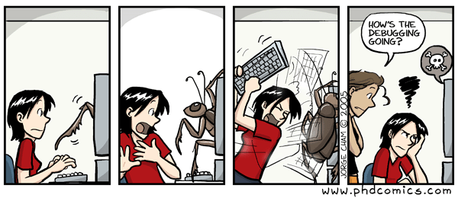
Before starting
Programming ≠ knowing everything
Numerous specialzed area (ML, NLP, Réseaux, …)
Not a magic wand
Long learning curve to become expert

Slide 28
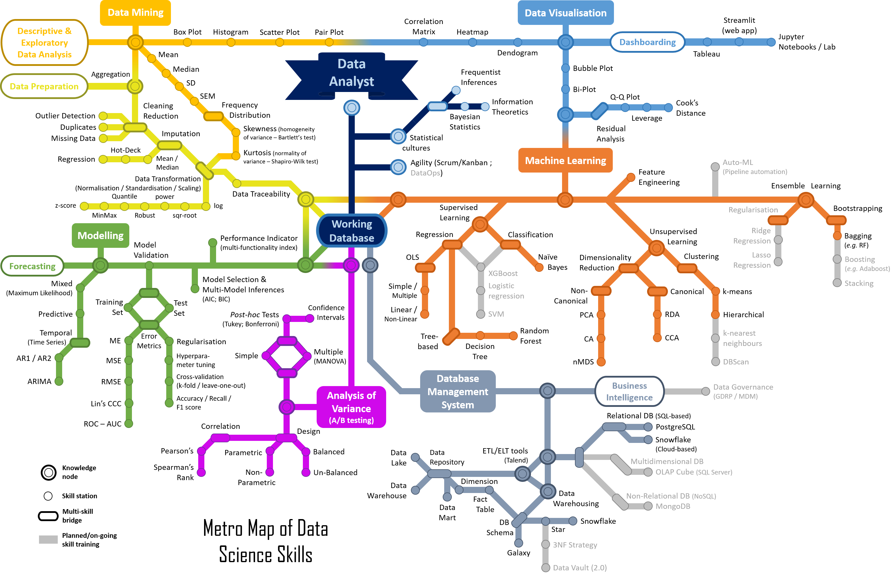
Programming ≠ data science

Slide 29
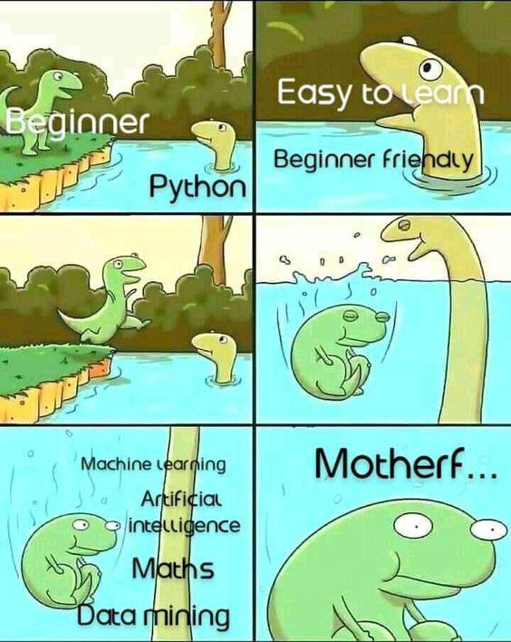
Going step-by-step

Slide 30
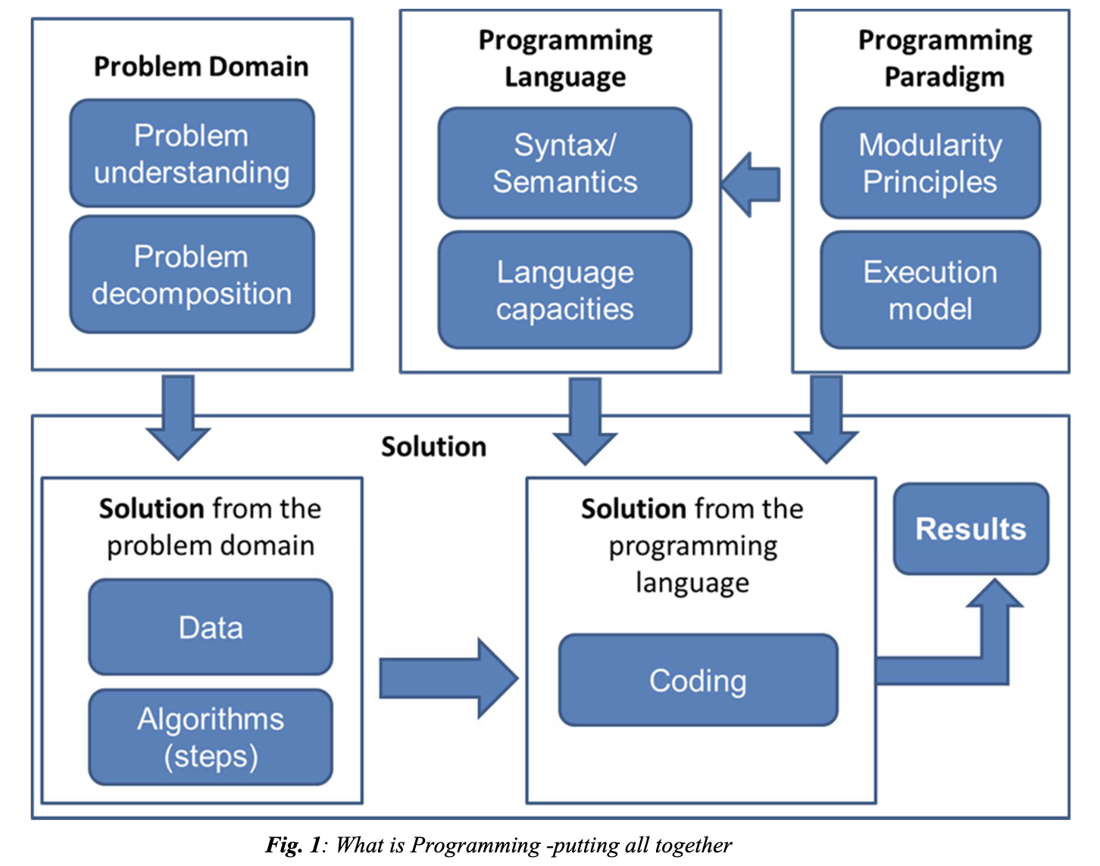

Slide 31
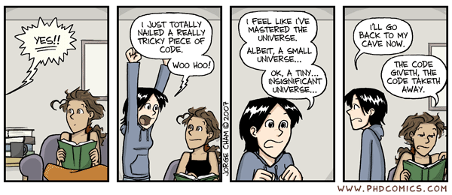
Small wins are important

Slide 32
Ressources

Slide 33
Online : Python for cultural studies, Melanie Walsh
Online : Python pour la data science, Lino Galiana

Slide 34
Running a script

Slide 35
Starting point
A content :
Python files .py
Notebooks .ipynb
A Python install
on your computer (e.g. Anaconda)
on a external service (e.g. Google colab)

Slide 36
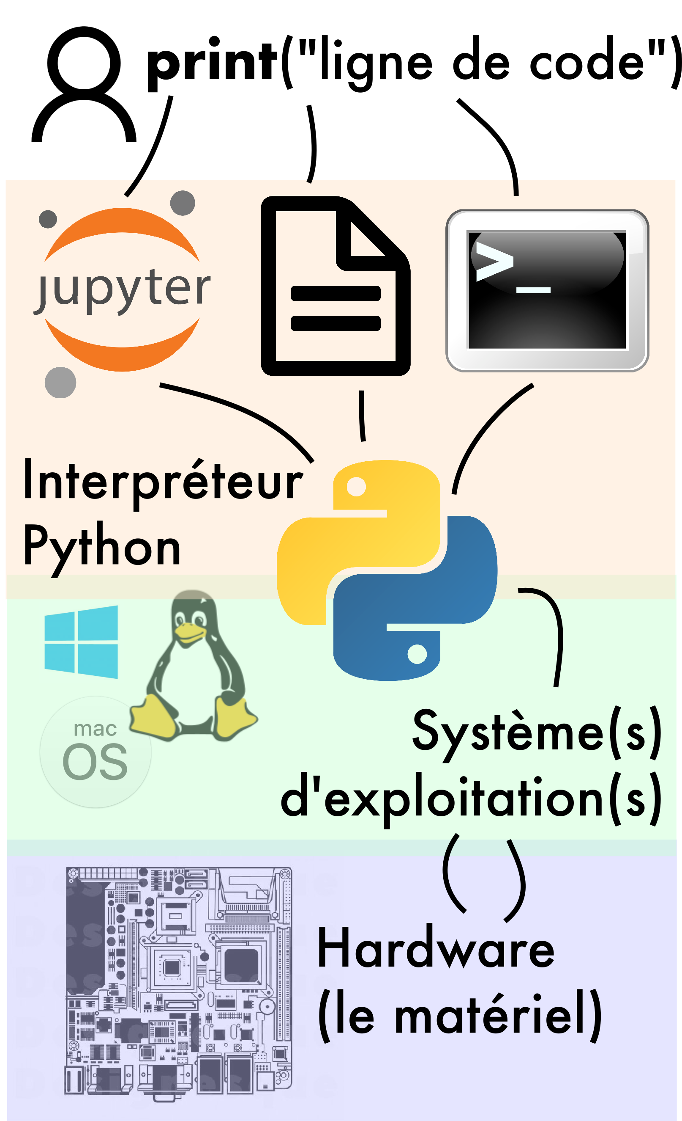
Python is a software
Different “entry points”
In the interactive software (console)
In a text file (+ Integrated (I)DE)
With a notebook (Interactive (I)DE)

Slide 37
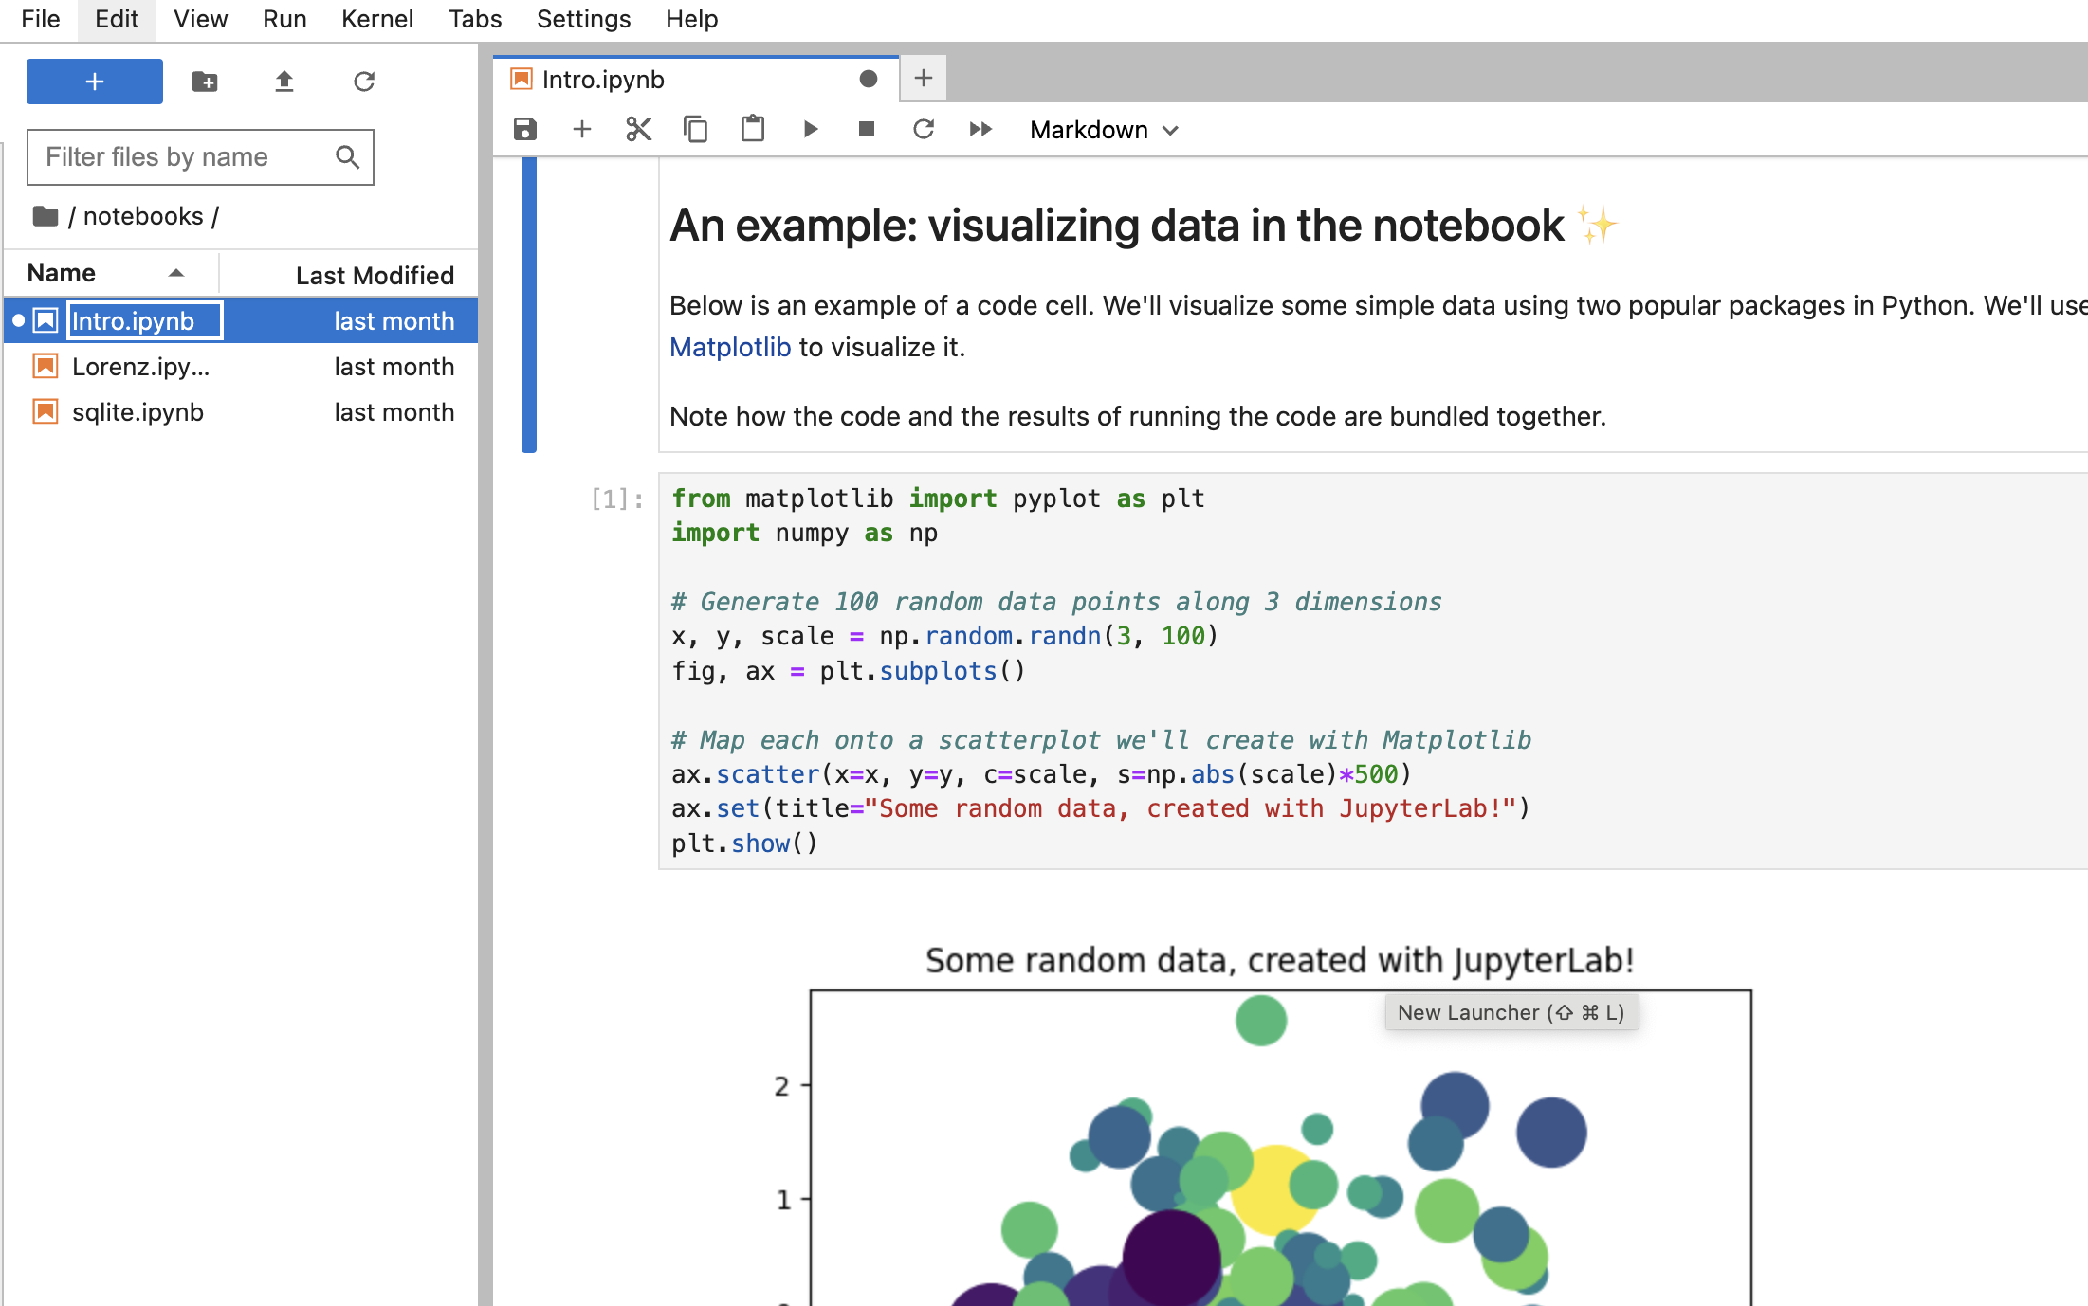
What are computational notebooks
The paradigm of litterate programming
The success of the Jupyter project

Slide 38
Jupyter or colab ?
Jupyter : open source project & protocol (developed since 2012)
Google Colaboratory : Google service (since 2018)
The question is : what are the computational ressources available through it ?

Slide 39
Why do we use colab ?
Scalable
Easy to access
GPU availability
A similar philosophy but some differences

Slide 40
Let’s launch a script

Slide 41
M2 - The basics of the language

Slide 42
Goals
Basics of Python (syntax)
Reading a script
Getting familiar with notebooks
we are only going to scratch the surface

Slide 43
Main notions
Variables/objects/data type
Built-in functions
Control structures
Focus on the general philosophy
If you need : Python cheat sheet

Slide 44
Learning through a script
Let’s read each line and unpack Python works

Slide 45
M3 - Toolkit for SICSS

Slide 46
Goals
Presenting main packages
Discussing small tips on Google Colab
Hands on to check if we are on the same page
Starting point :
Open a notebook (Google Colab)
Run a few lines of code

Slide 47
Functions in Python
The Python Standard Library
len, type
modules math, os, …
User-defined functions
def myfunction(): # do something return something
Quick exercice
Count the number of words in a text

Slide 48
Libraries in Python

Slide 49
Each library comes with its philosophy and community

Slide 50
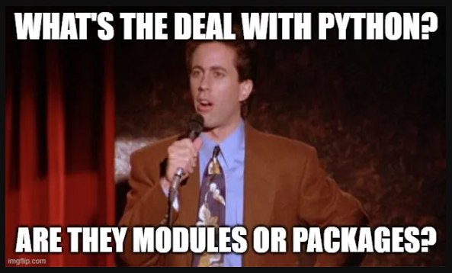
Different types of code
Scripts, module, packages, libraries

Slide 51
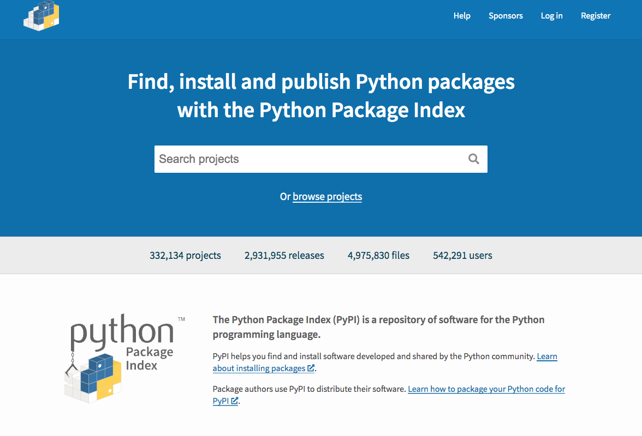
Install a library
pip install XXXXX

Slide 52
then import
import XXXXX

Slide 53
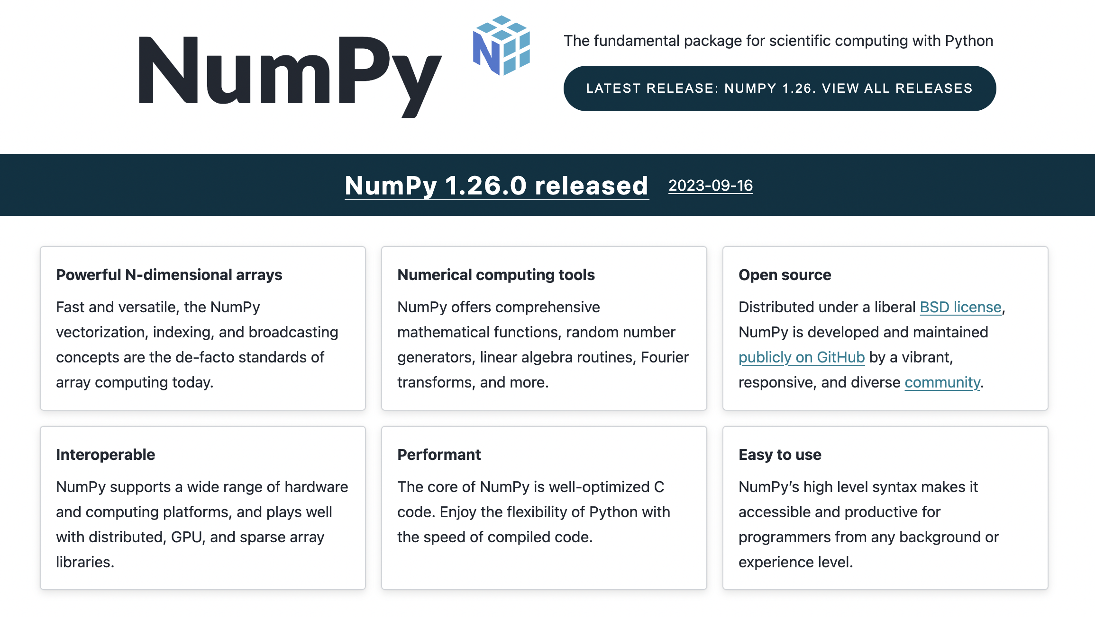
Numpy : hidden layer

Slide 54
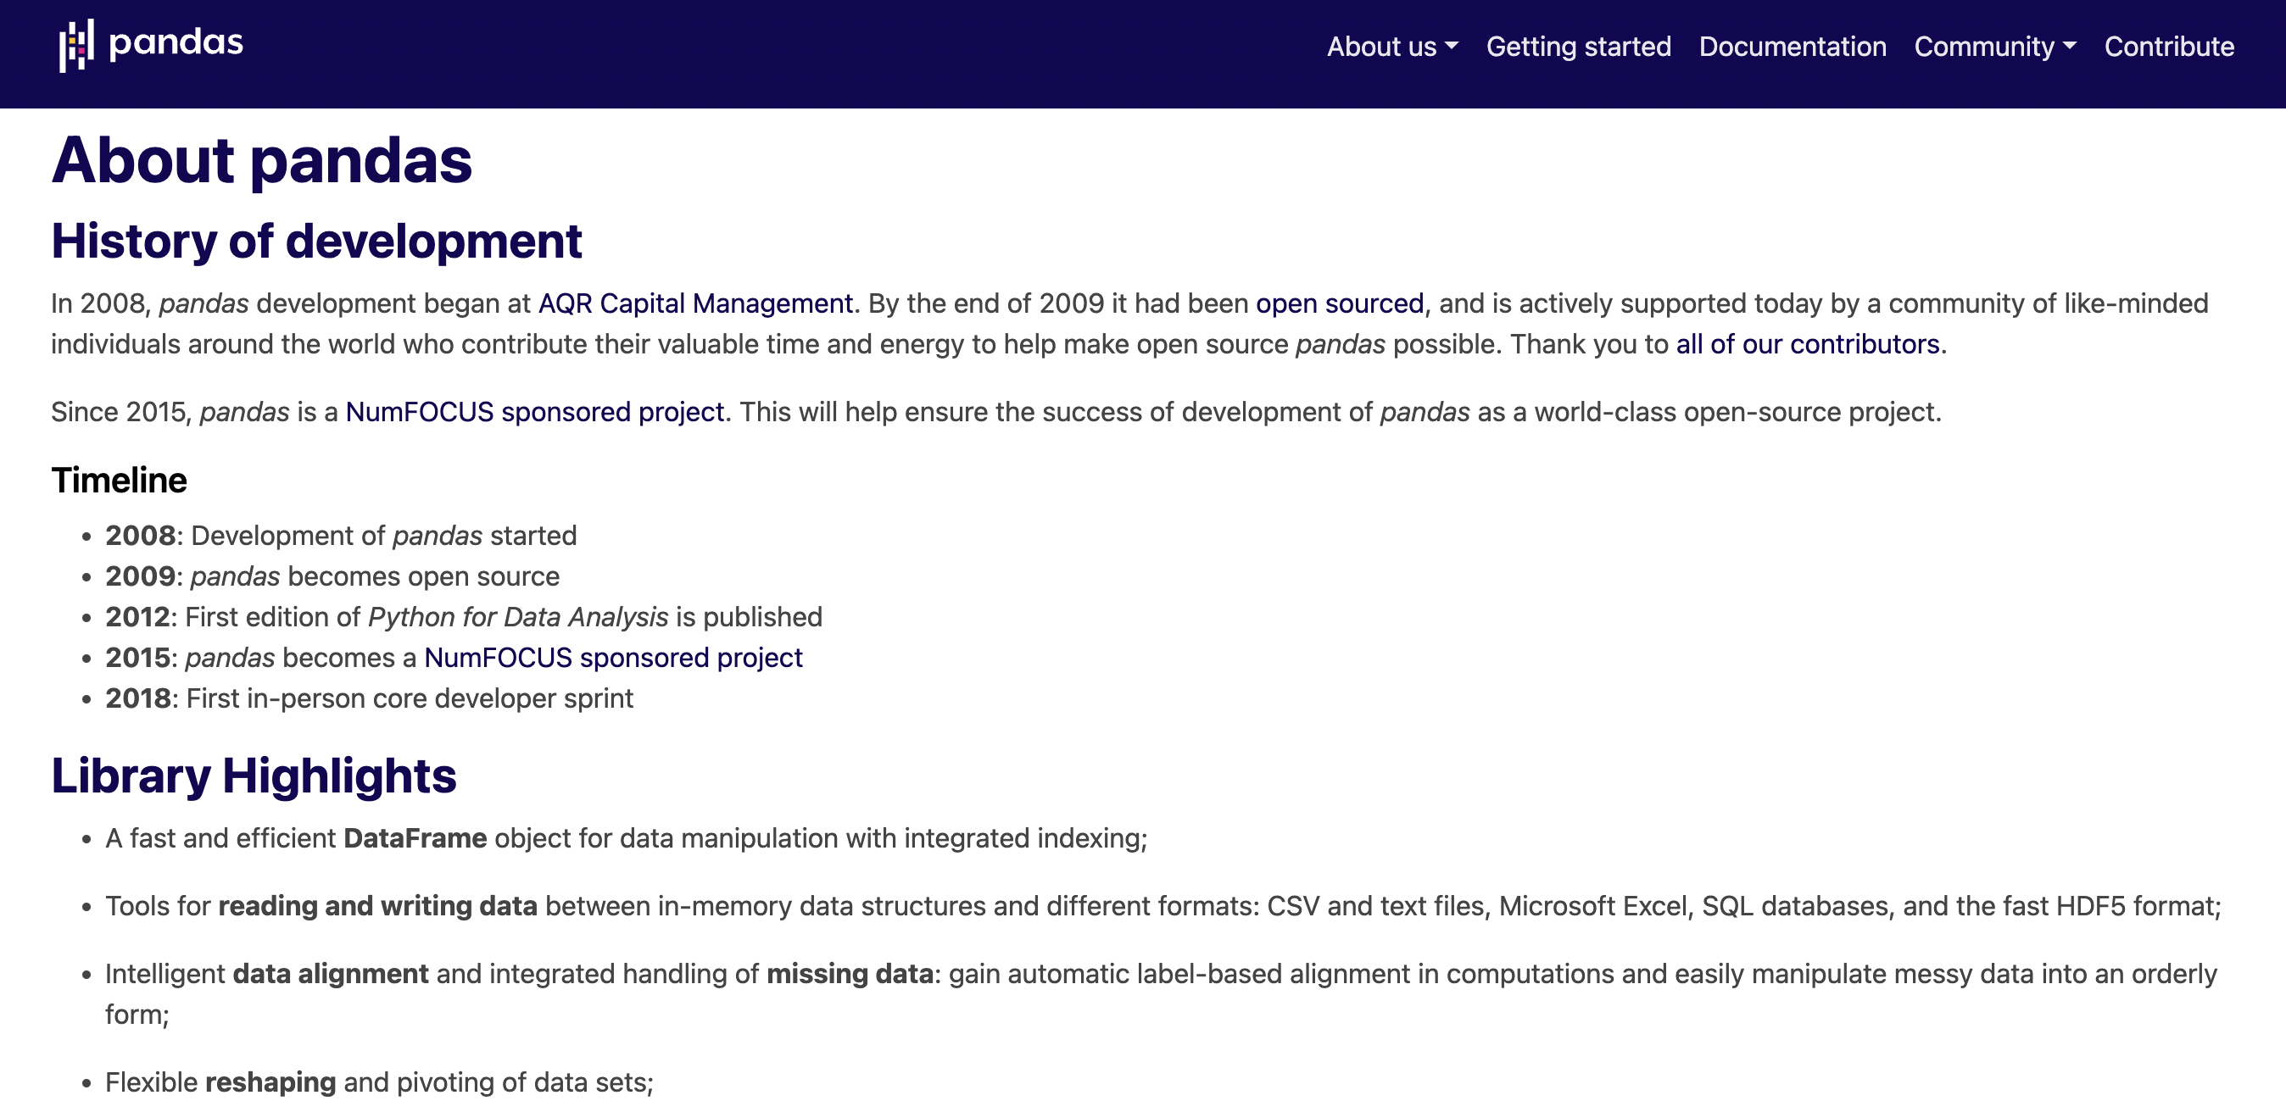
Pandas : excel for Python

Slide 55
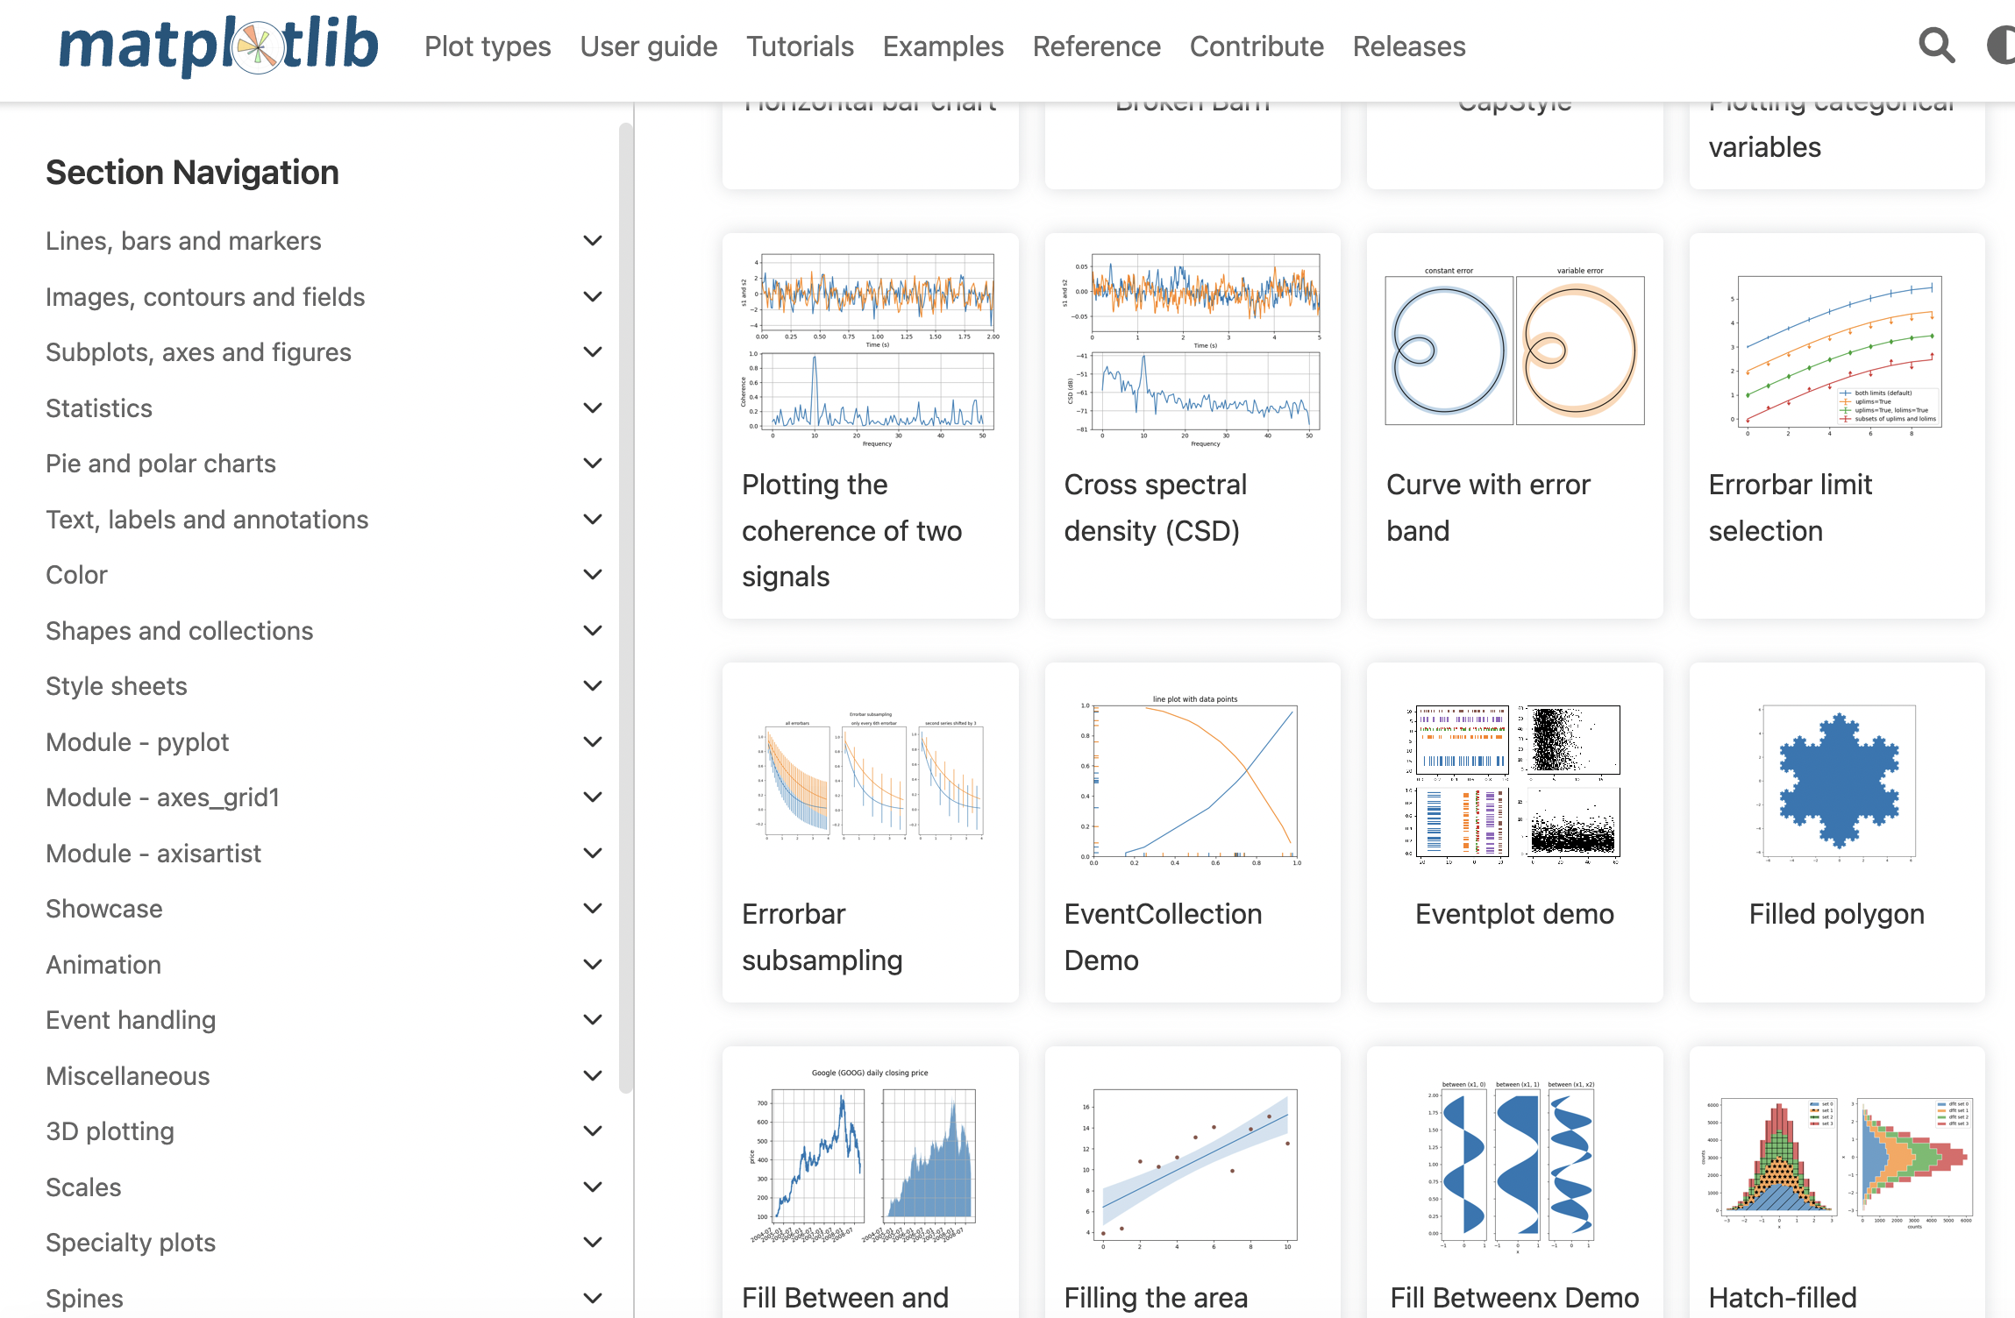
Matplotlib : vizual grammar

Slide 56
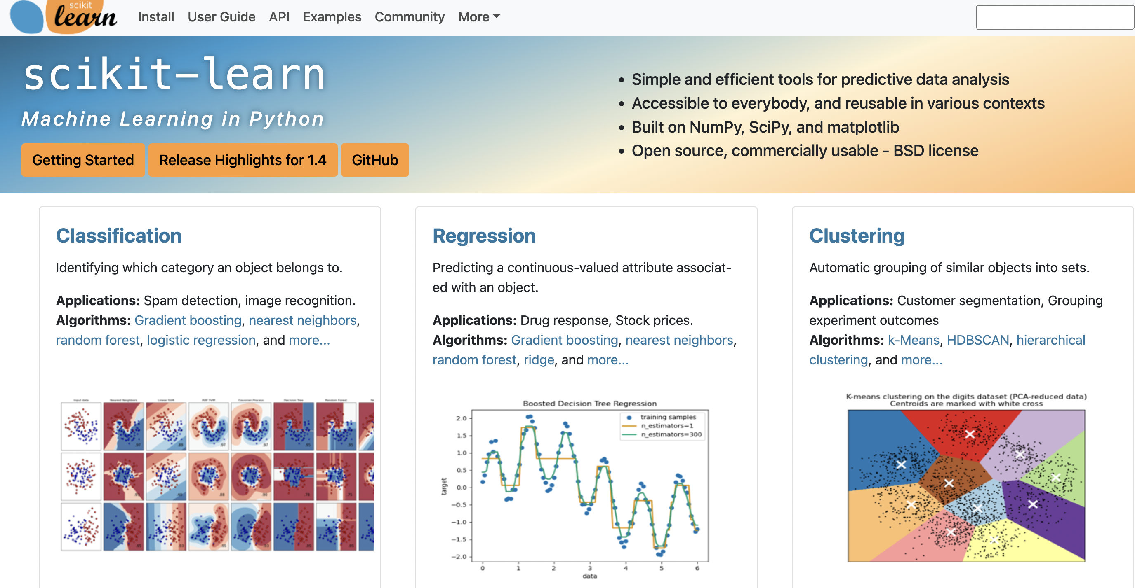
Scikit-learn : machine learning

Slide 57
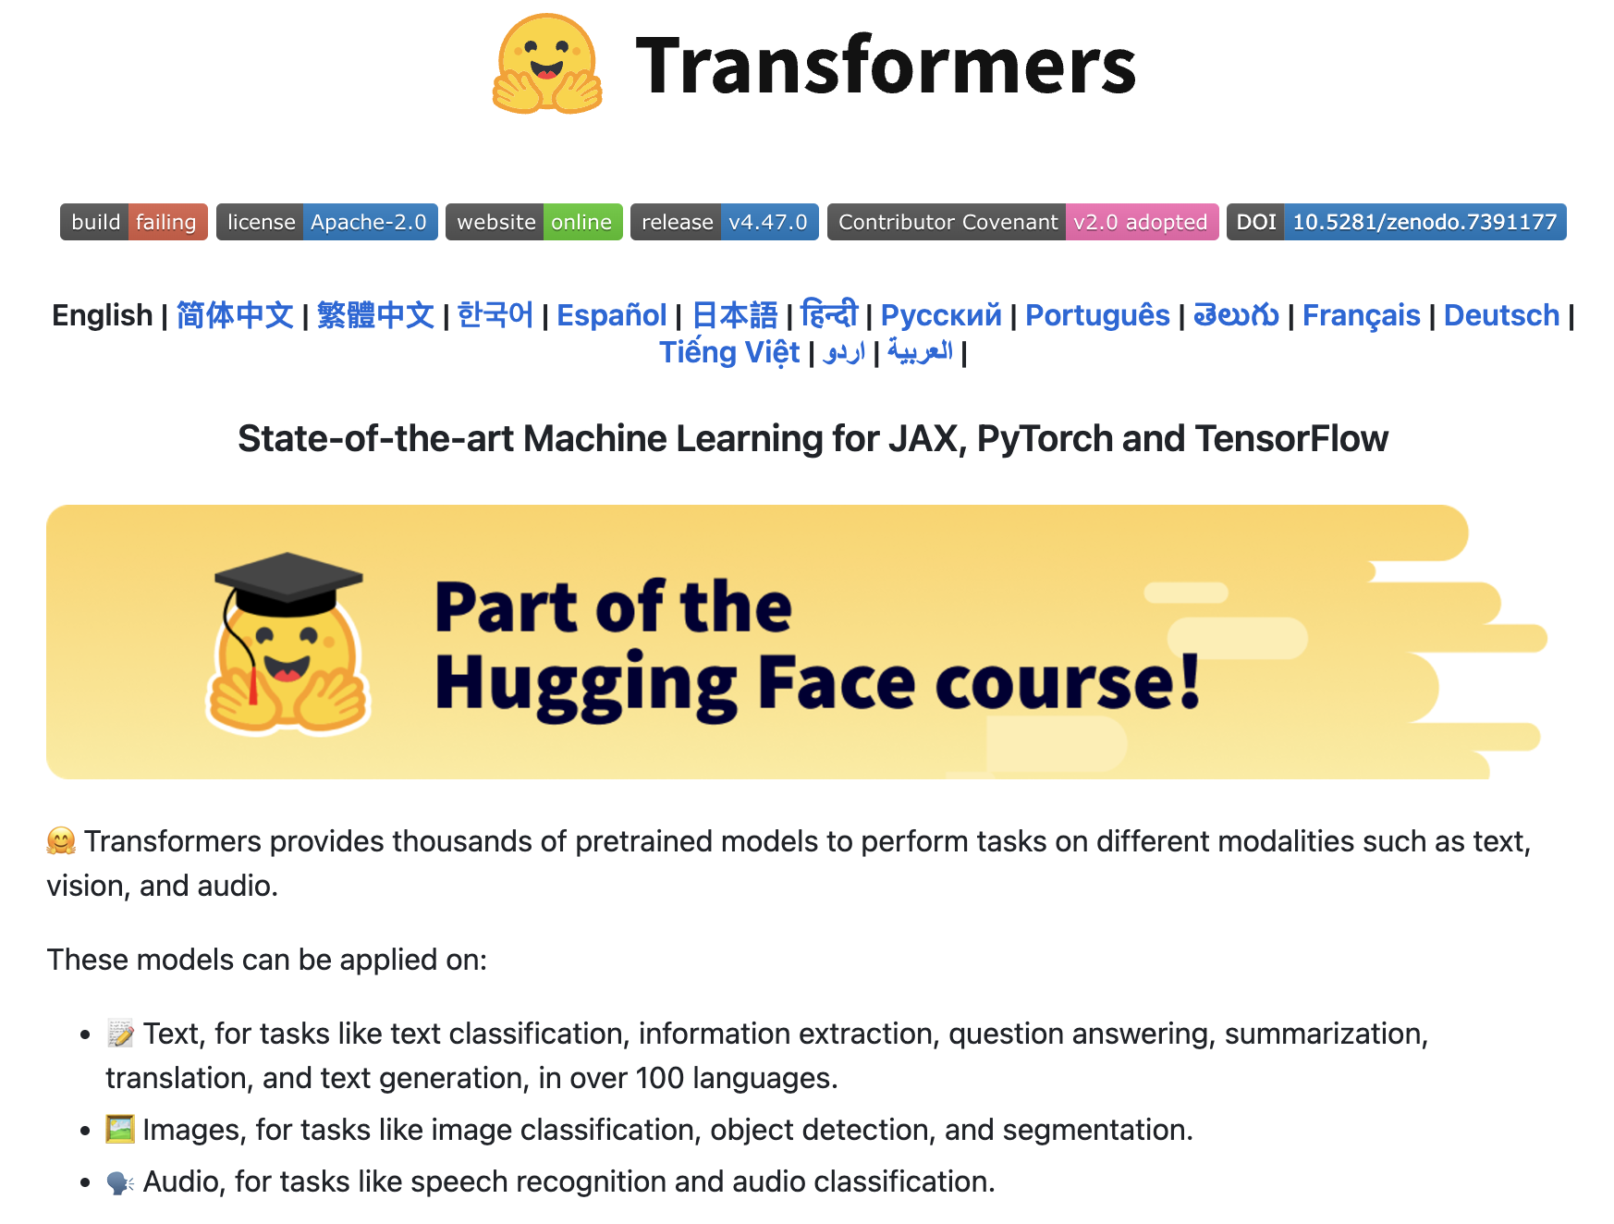
Transformers : models

Slide 58
Notions of filesystem
Notions :
working directory .
absolute/relative path
parent folder ..

Slide 59
Important CLI
ls : list files
cd : change directory
pwd : print working directory
mkdir : make directory
rm : remove
cp : copy
…

Slide 60
Connecting drive
Data should be separated from code.
So the question is to access to the data.
from google.colab import drive drive.mount('/content/drive')

Slide 61
Hands-on to check
Use the code from https://github.com/emilienschultz/sicss2025
Open a dataset with Pandas
Create a graph
Predict the number of citation

